Slide 1
Jersey Citibike Dashboard

Slide 2
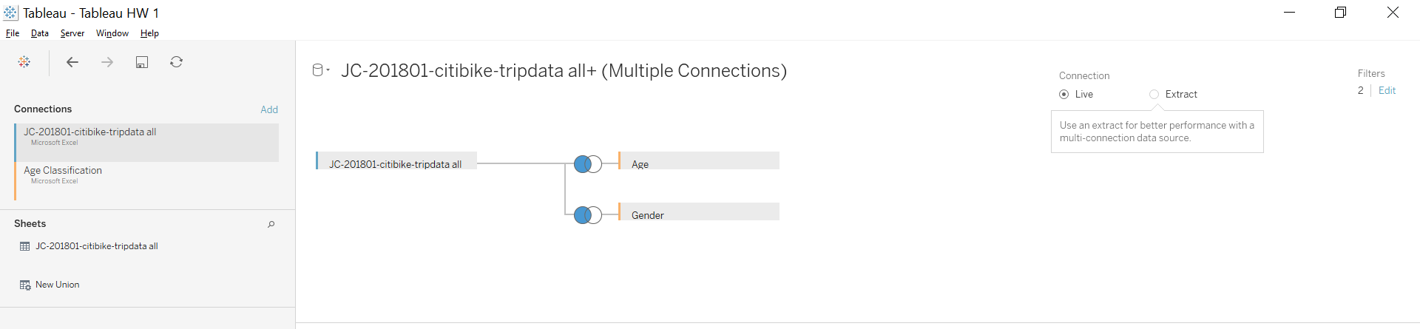
Process
Downloaded all data for Jersey City in 2018
Unioned the tables of data in Tableau
Found bad data in Unknown Gender (primarily at 50 years old) and Age (found cases of people over 100 years old)
Used Data Source Filter to remove it
Added two tables by left join to enhance information
Classify Gender and Ages into bins and Age Groups

Slide 3
Enhancements
Created Age Bins to classify users
Created Calculated fields:
Duration of Trip
Age of rider
Ride Type (Round Trip or One Way

Slide 4
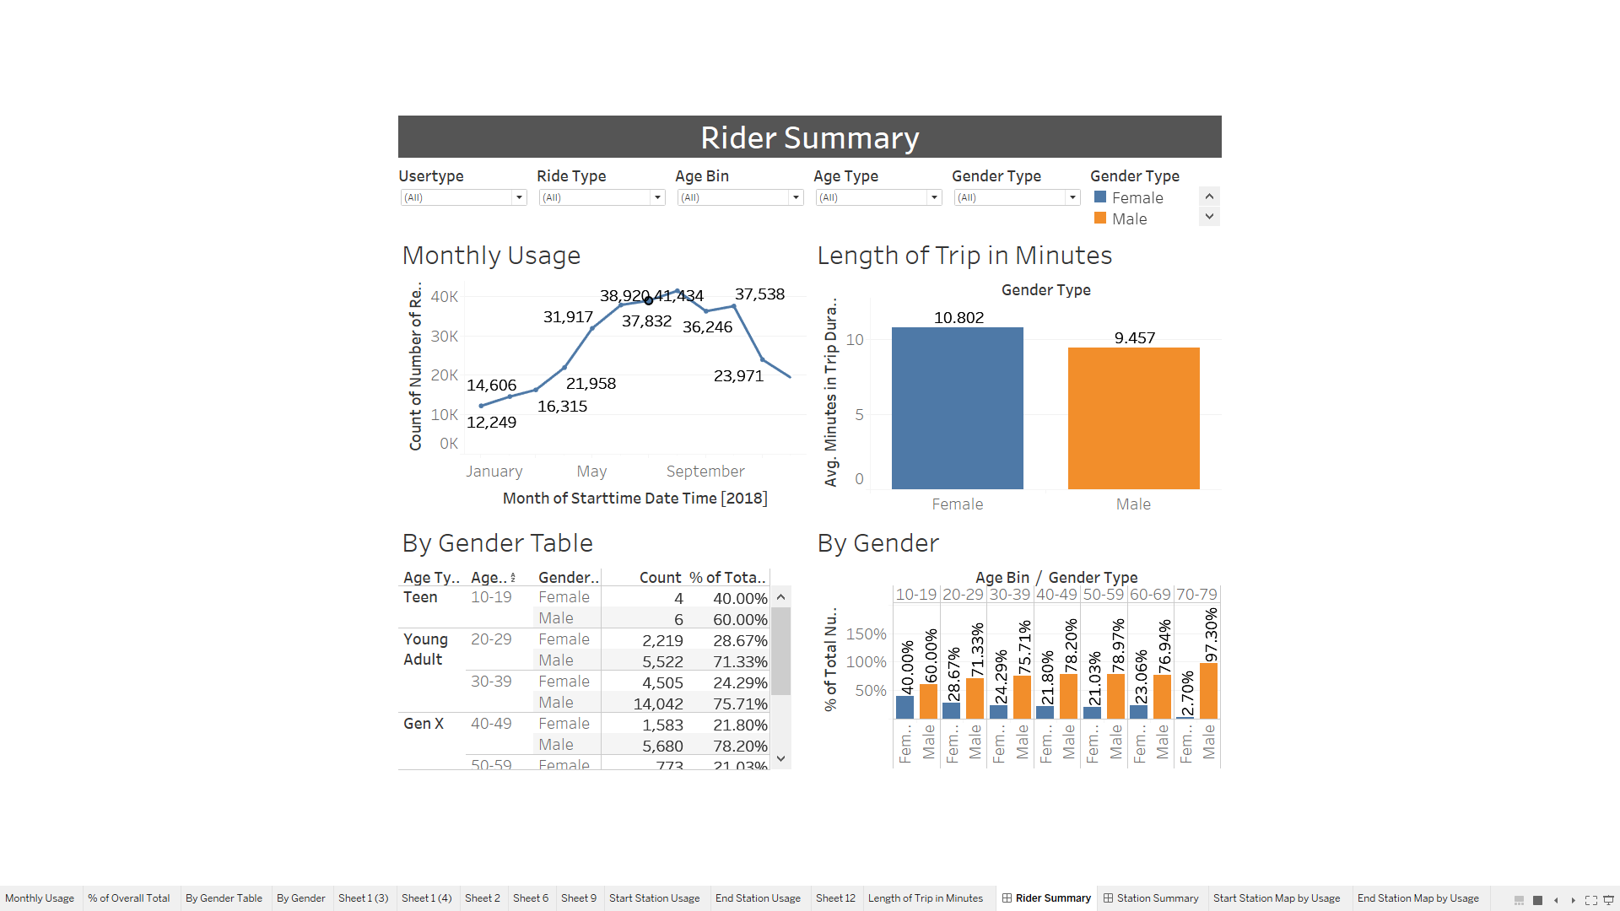
Rider Summary

Slide 5
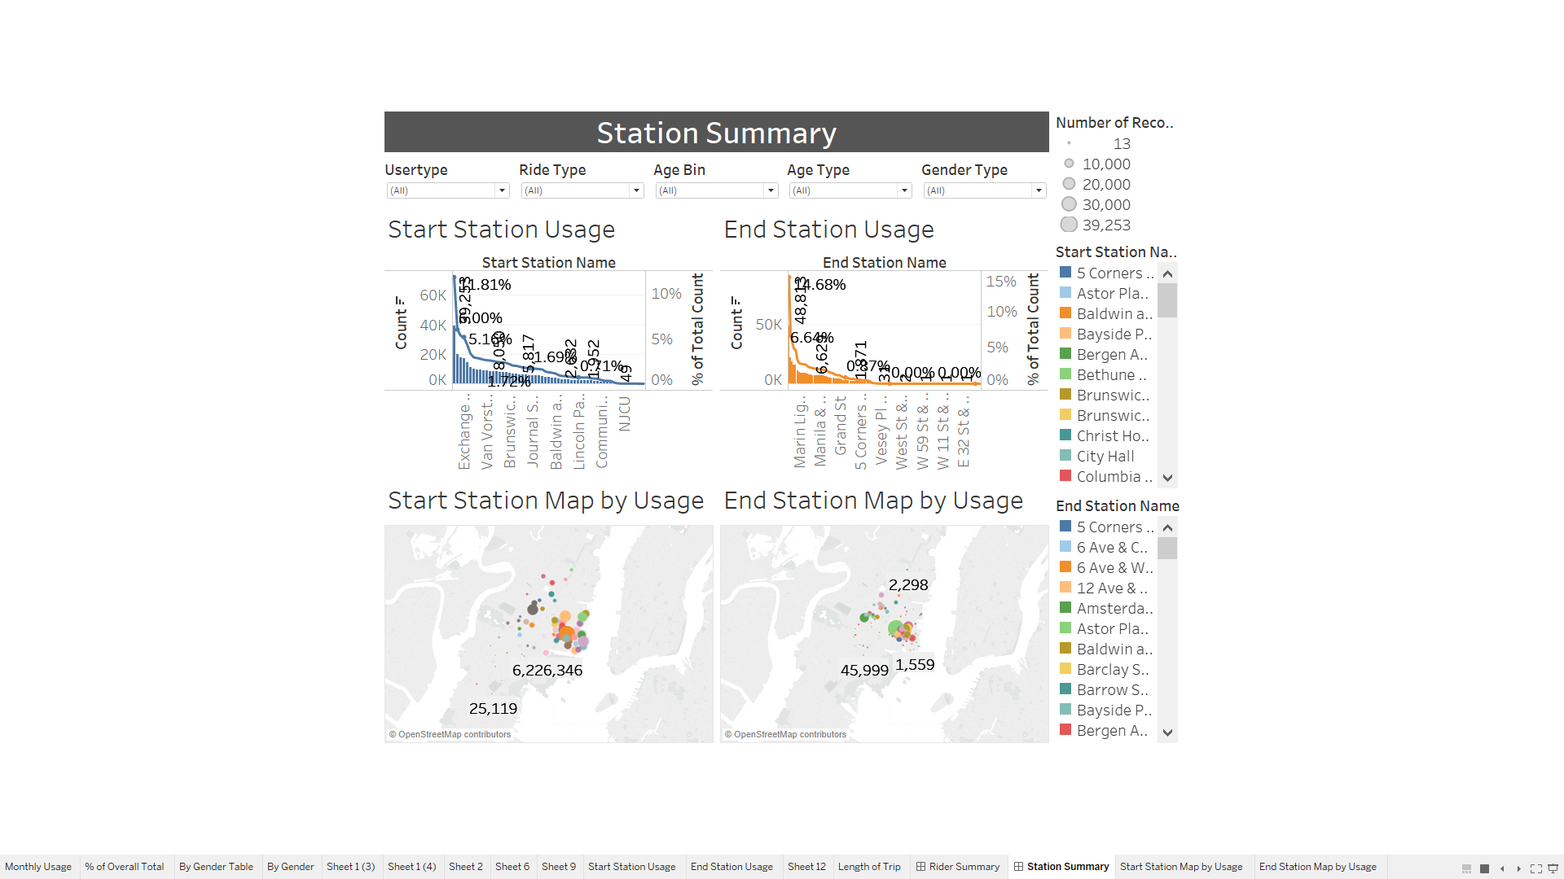
Station Summary

